Slide 1
Photomicrographs of Plant Seeds
Okra
Permission to reproduce original photomicrographs used to make this collection may be obtained from
Dr. David O. Norris at
david.norris@colorado.edu

Slide 2
10X
Okra seed
Notes:
Okra seed (left and right sides) [Abelmoschus esculentus (L.) Moench].

Slide 3
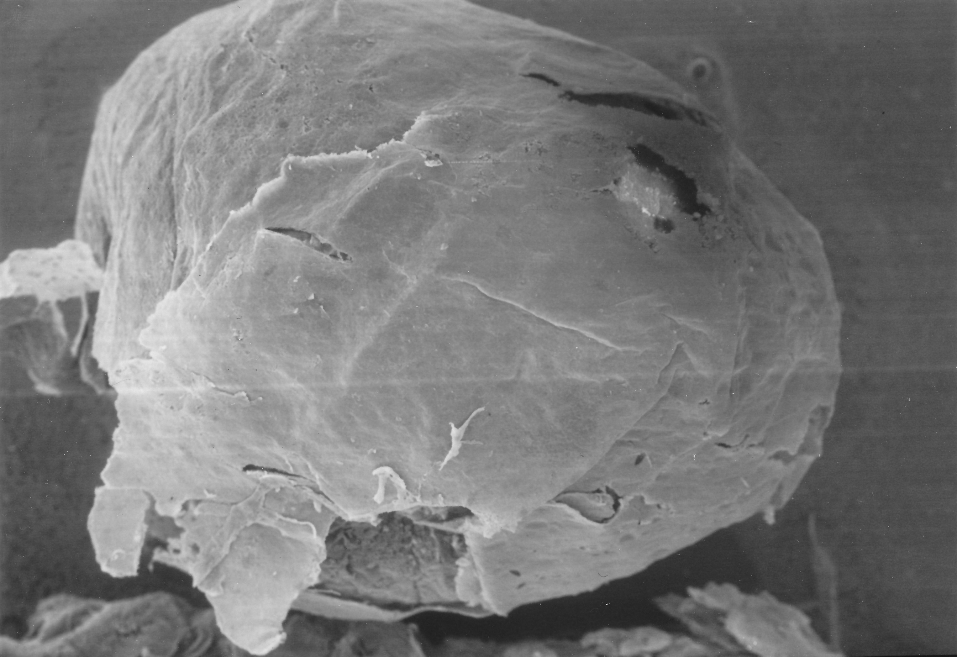
Okra seed
1000 µm
Notes:
S41. Okra seed [Abelmoschus esculentus (L.) Moench]. SEM courtesy of Dr. Meredith A. Lane

